Slide 1
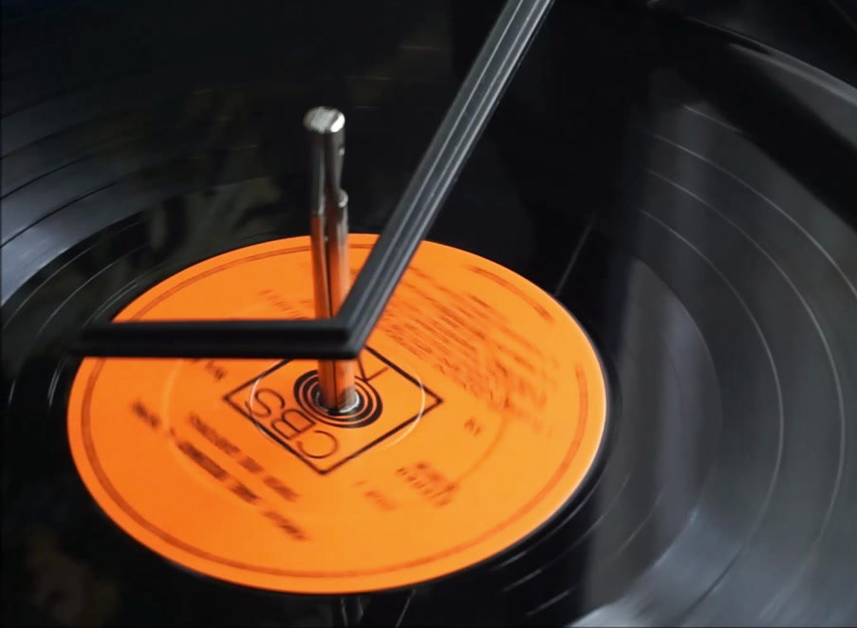
RAMSES MENDOZA SONG RECOMMENDER
01

Slide 2

Spotify's recommender vs. Ramses's recommender?
Music recommended from a musician's point of view
02

Slide 3
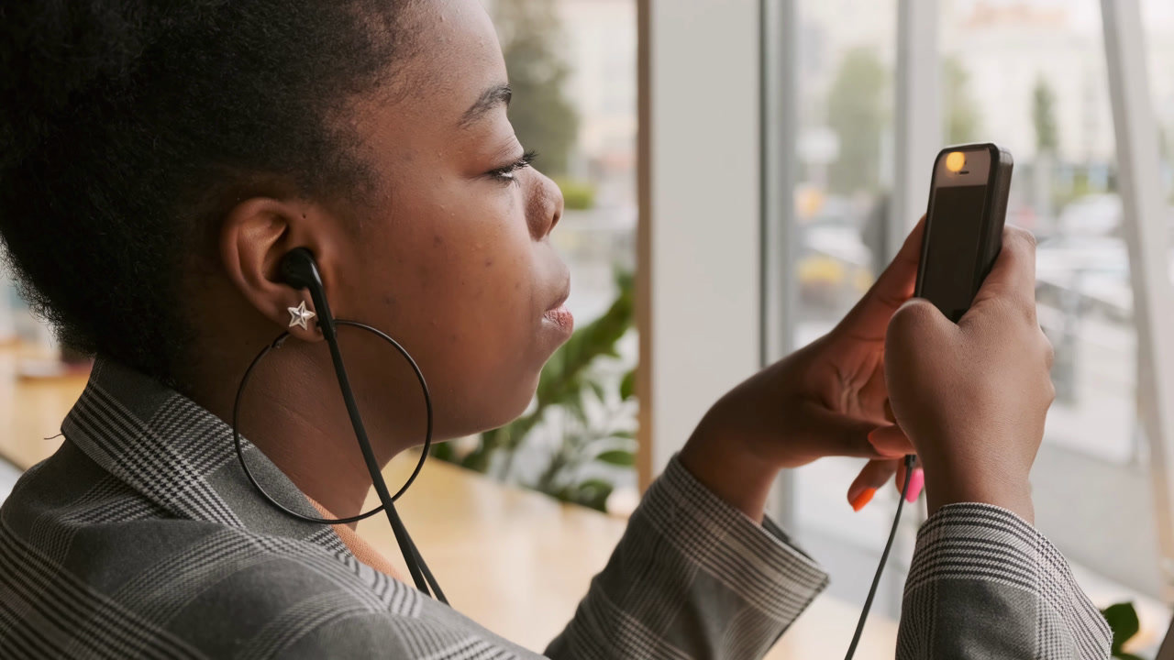

soundwave
spectrum
audio analisis
against
audio features
03

Slide 4

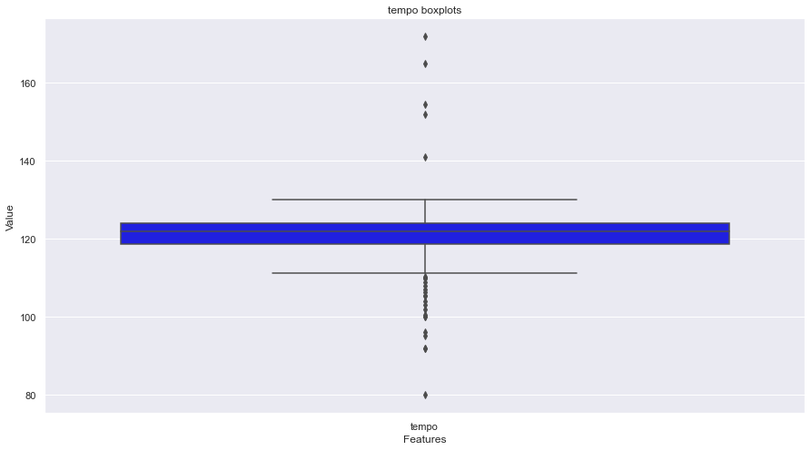
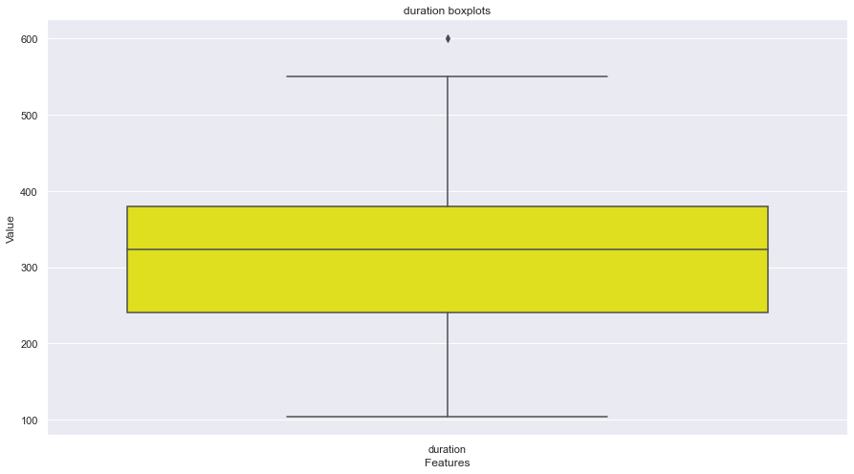
What i found?
04

Slide 5
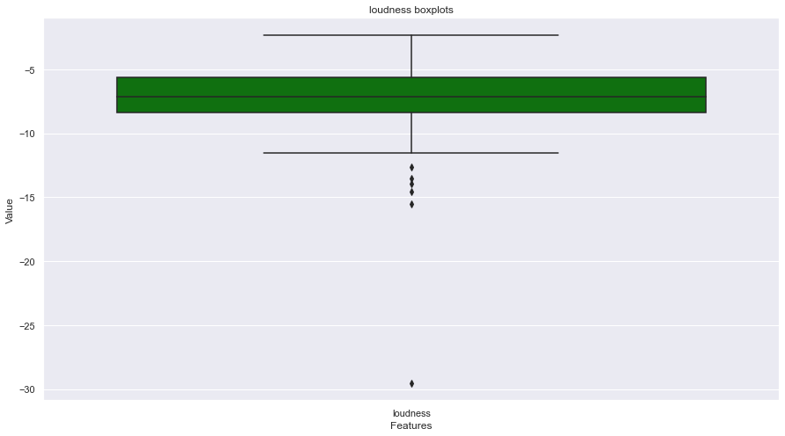
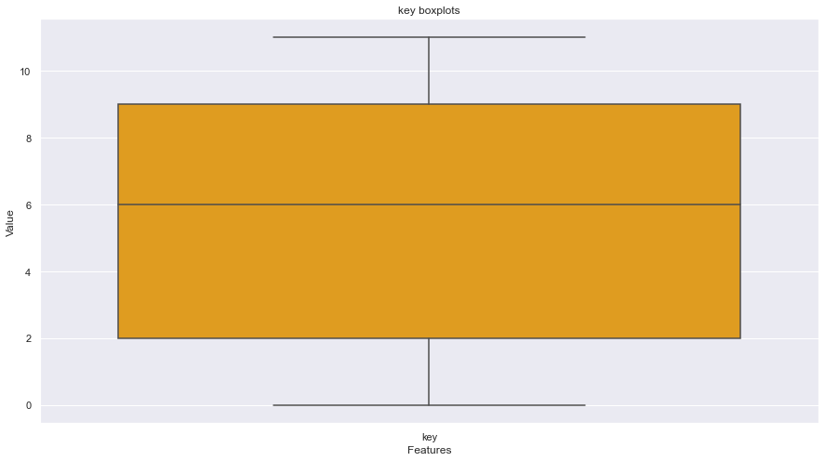
What i found?
05

Slide 6
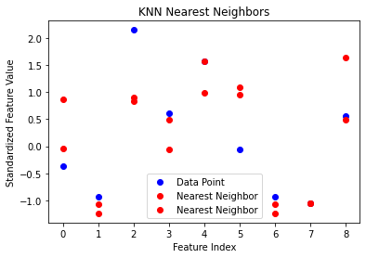
What i did?
06

Slide 7
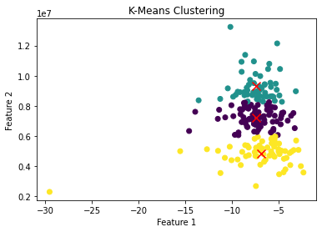
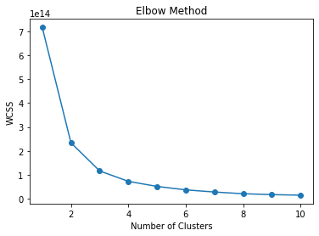
What i did?
07

Slide 8
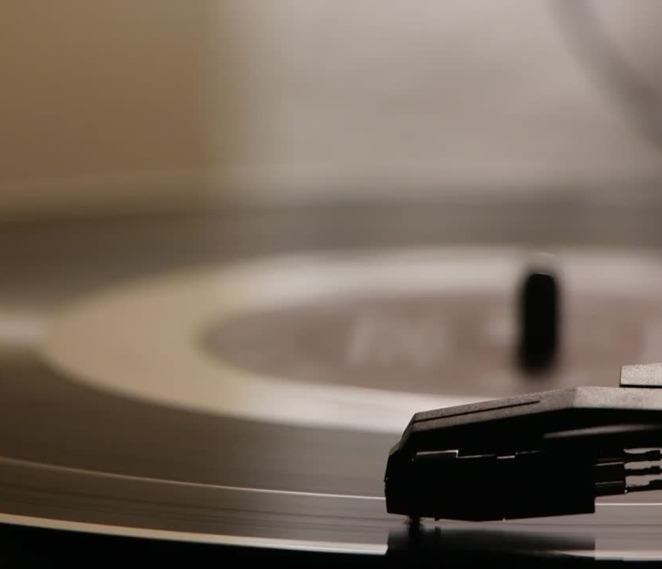
Conclusions
08

Slide 9


Thank You
Ramses-Mendoza-Ruiz
RamsesMR
09

